Slide 1
Analyse Car Listings

Slide 2
Objectives
This program is designed to analyse car listings from Motorist and SGCarMart websites, extracting pricing and depreciation data to generate a summarized report in both CSV and PowerPoint formats
Features
Custom GUI: Enter URLs directly through an intuitive interface.
Web Scraping: Scrapes depreciation data from car listing websites.
CSV Output: Saves processed results into CSV files.
PowerPoint Summary: Automatically generates a PowerPoint presentation with the top 3 and bottom 3 listings by depreciation for each car model.
Code
gui.py: Handles the graphical user interface, collects URLs, and triggers the analysis process.
scrape_and_process.py: The main logic for scraping data from the websites and processing the car listings.
Search Analysis.py: Contains search analysis functions that process the scraped data and create output files.
Data
For each website and each car make searched for, every single car for sale on the list for that specific make of car will have its respective price, depreciation value and exact model listed in the output files

Slide 3
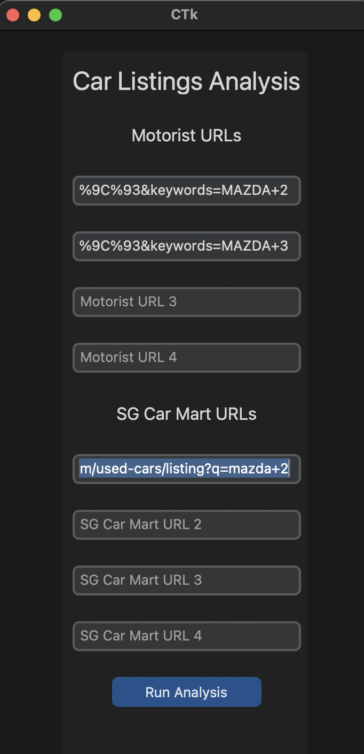
How to Use
Input URLs to each desired list of car makes/models
Click Run Analysis
Open the newly created CSV and PPT files and view every car’s pricing and depreciation value at your leisure

